Slide 1
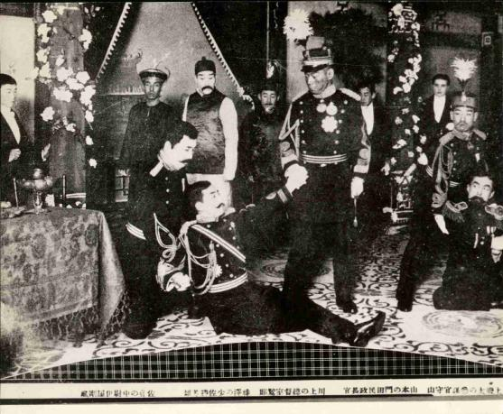
Shakespeare’s Othello
Kawakami Otojiro’s Osero (1903), an adaptation of Shakespeare’s Othello
Photo preserved in the Tsubouchi Memorial Theatre Museum of Waseda

Slide 2
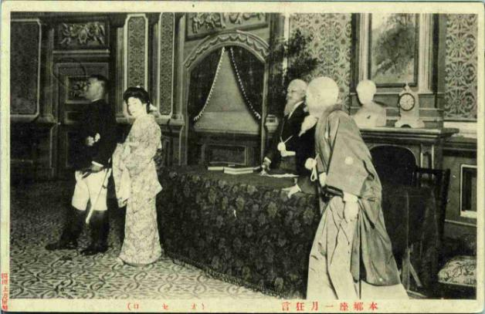
Kawakami Otojiro’s Osero (1903)
The premiere of Othello in Taiwan was in Sakae-za in 1905.
Tomone, the Japanese Desdemona, in Kawakami Otojiro’s Osero (1903), an adaptation of Shakespeare’s Othello
Photo preserved in the Tsubouchi Memorial Theatre Museum of Waseda

Slide 3
Othello
Othello - A Moor and general of Venice
Desdemona -The daughter of the Venetian senator Brabanzio.
Cassio - Othello’s lieutenant.
Bianca - A courtesan, or prostitute, in Cyprus.
Iago - Othello’s soldier
Emilia - Iago’s wife and Desdemona’s attendant.

Slide 4
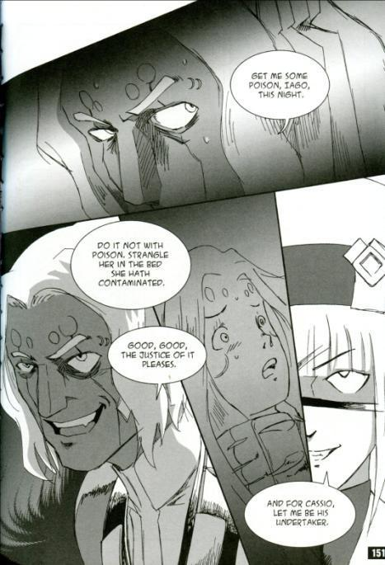
Manga Shakespeare Othello, illustrated by Ryuta Osada
Osada’s Othello is set in a sci-fi world, where winged beings behave between animals and humans.

Slide 5
V.2.1-5
Othello
It is the cause, it is the cause, my soul: let me not name it to you, you chaste stars. It is the cause. Yet I’ll not shed her blood, nor scar that whiter skin of hers than snow and smooth as monumental alabaster —yet she must die, else she’ll betray more men.
Cause: adultery—Othello tries to justify his intended course of action
whiter skin of hers than snow: whiter than snow
monumental alabaster: a translucent stone used in making monuments
Betray: deceive

Slide 6
V.2.6-10
Put out the light, and then put out the light: if I quench thee, thou flaming minister, I can again thy former light restore, should I repent me; but once put out thy light:
Put out the light: (a) the torch he carries; b) Desdemona’s life
Quench: extinguish
flaming minister: the lamp in his hand
Should: if

Slide 7
V.2.11-15
cunning’st: most artful
Pattern: model
Promethean heat: Prometheus steals fire from the gods to animate the clay figures he had modeled, thus creating the first human beings
relume: rekindle
OTHELLO
thou cunning’st pattern of excelling nature, I know not where is that Promethean heat that can thy light relume. When I have pluck’d thy rose, I cannot give it vital growth again; it needs must wither. I’ll smell it on the tree.
He Kisses her

Slide 8
V.2.16-22
O Balmy breath, that dost almost persuade justice to break her sword! One more, one more! Be thus when thou art dead, and I will kill thee and love thee after. One more, and this the last. So sweet was ne’er so fatal. I must weep. But they are cruel tears: this sorrow’s heavenly—it strikes where it doth love. She wakes.
Balmy: soft
her sword: the weapon for the execution of justice!

Slide 9
V.2.23-29
DESDEMONA
Who's there? Othello?
OTHELLO
Ay. Desdemona.
DESDEMONA
Will you come to bed, my lord?
OTHELLO
Have you pray'd to-night, Desdemona?
DESDEMONA
Ay, my lord.
Othello
If you bethink (remember) yourself of any crime unreconcil’d as yet to heaven and grace (not forgiven by God), solicit (ask pardon) for it straight (immediately).

Slide 10
V.2.30-37
DESDEMONA
Alas, my lord, what do you mean by that?
Othello
Well, do it, and be brief: I will walk by (i.e. he will allow Dedsdemona privacy for her confession): I would not kill thy unprepared spirit (unprepared; not prepared for heaven); no—heaven forfend (forbid)!—I would not kill thy soul.
DESDEMONA
Talk you of killing?
OTHELLO
Ay, I do.
DESDEMONA
Then heaven
Have mercy on me!

Slide 11
V.2.48-52
OTHELLO
That handkerchief which I so loved and gave thee
Thou gavest to Cassio.
DESDEMONA
No, by my life and soul!
Send for the man, and ask him.
OTHELLO
Sweet soul, take heed,
Take heed of perjury; thou art on thy death-bed.
DESDEMONA
Ay, but not yet to die.
Othello
Yes, presently (at once).

Slide 12
V.2.53-62
OTELLO
Therefore confess thee freely (fully) of thy sin; for to deny each article (item of which she is accused) with oath cannot remove nor choke (killed by strangling) the strong conception (suspicion) that I do groan withal (labour with; Othello’s suspicions of Desdemona are causing pain like birth pangs). Thou art to die.
DESDEMONA
Then Lord have mercy on me!
OTHELLO
I say, amen.
Desdemona
And have you mercy too! I never did offend you in my life; never lov’d Cassio but with such general warranty (ordinary permission) of heaven as I might love. I never gave him token.

Slide 13
V.2.63-70
Othello
By heaven, I saw my handkerchief in’s hand. O perjur’d woman! Thou dost stone my heart (turn my heart to stone), and mak’st me call what I intend to do a murder, which I thought a sacrifice (Desdemona’s refusal to accept her guilt makes a murder of what Othello intended to be a sacrificial gesture). I saw the handkerchief.
Desdemona
He found it then; I never gave it him. Send for him hither (order him to come here); let him confess a truth.
OTHELLO
He hath confess'd.
DESDEMONA
What, my lord?

Slide 14
V.2.71-77
Othello
That he hath us’d thee (sexually).
DESDEMONA
How? unlawfully?
OTHELLO
Ay.
DESDEMONA
He will not say so.
Othello
No, his mouth is stopp’d (he has been silenced): honest Iago hath tane order for’t (seen to it).
Desdemona
O, my fear interprets (I am afraid I understand)! What, is he dead?
1:39:00-1:42:00

Slide 15
V.2.79-83
OTHELLO
Out, strumpet! weep'st thou for him to my face?
DESDEMONA
O, banish me, my lord, but kill me not!
OTHELLO
Down, strumpet!
DESDEMONA
Kill me to-morrow: let me live to-night!
OTHELLO
Nay, if you strive--
DESDEMONA
But half an hour!

Slide 16
V.2.84-88
OTHELLO
Being done, there is no pause (Now I have started, I must go on).
Desdemona
But (only) while I say one prayer!
OTHELLO
It is too late.
EMILIA
[Within] My lord , my lord! what, ho! my lord, my lord!
OTHELLO
What noise is this? Not dead? not yet quite dead?
I that am cruel am yet merciful;
I would not have thee linger in thy pain:
So, so.

Slide 17
V.2.89-98
EMILIA
[Within] What, ho! my lord, my lord!
OTHELLO
Who's there?
EMILIA
[Within] O, good my lord, I would speak a word with you!
Othello
Yes—‘tis Emilia—by and by.—She’s dead. ‘tis like (likely) she comes to speak of Cassio’s death: the noise was high. Ha! No more moving? Still as the grave. Shall she come in? Were’t good? I think she stirs again. No. What’s the best to do? If she come in, she’ll sure speak to my wife—my wife, my wife! What wife? I have no wife.

Slide 18
V.2.99-102
OTHELLO
O insupportable! O heavy hour! Methinks it should be now a huge eclipse of sun and moon, and that th’affrighted globe should yawn at alteration.
O insupportable: I can’t bear it;
th’affrighted globe: the whole world
Yawn: tear itself apart in an earthquake
Alteration: the change brought about by Desdemona’s death

Slide 19
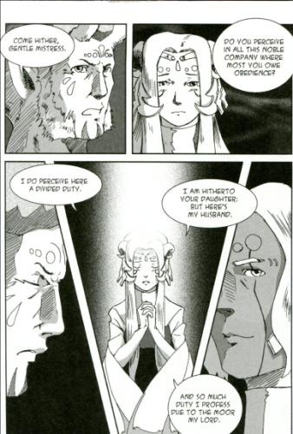
Shakespeare’s Othello
Act I Scene 3
Desdemona’s confession reveals the themes in relation to racial conflict and gender role conflict
Image is take from Manga Shakespeare Othello, illustrated by Ryuta Osada

Slide 20
Othello
Othello, the Moor
Iago, Othello’s officer and Emilia’s husband
Roderigo, a Venetian in love with Desdemona
Cassio, Othello’s lieutenant
Desdemona, Othello’s wife
Emilia, Desdemona’s maid and Iago’s wife
Brabantio, Desdemona’s father
Duke of Venice

Slide 21
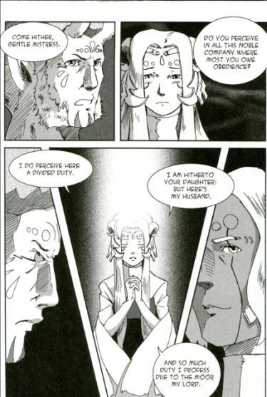
I.3.178-188
BRABANTIO
Come hither, gentle mistress:
Do you perceive in all this noble company
Where most you owe obedience?
DESDEMONA
My noble father,
I do perceive here a divided duty:
To you I am bound for life and education (upbringing);
My life and education both do learn me (instruct me)
How to respect you; you are the lord of duty;
I am hitherto (so far) your daughter: but here's my husband,
And so much duty as my mother show'd
To you, preferring you before her father,
So much I challenge (claim) that I may profess
Due to the Moor my lord.

Slide 22
I.3.189-198
BRABANTIO
God bu'y (God be with you)! I have done.
Please it your grace, on (let us proceed with) to the state-affairs:
I had rather to adopt a child than get (beget) it.
Come hither, Moor:
I here do give thee that (i.e. Desdemona) with all my heart
Which, but thou hast already (except you have it already), with all my heart
I would keep from thee. For your sake (on your account), jewel,
I am glad at soul (in my heart) I have no other child:
For thy escape (elopement) would teach me tyranny,
To hang clogs (blocks of wood fastened to the legs of horses to prevent their escape) on them. I have done, my lord.

Slide 23
I.3.221-228
Skip
DUKE OF VENICE
The Turk with a most mighty preparation (armed force) makes for
Cyprus. Othello, the fortitude ( defensive strength) of the place is best
known to you; and though we have there a substitute (deputy, i.e Montano,)
of most allowed sufficiency (recognized efficiency), yet opinion (public opinion), a
sovereign mistress of effects (which makes the final decision in these matters), throws a more safer
voice on you (votes for you as the safer choice): you must therefore be content to
slubber (tarnish) the gloss of your new fortunes with this
more stubborn (tougher) and boisterous (violent) expedition (assignment).

Slide 24
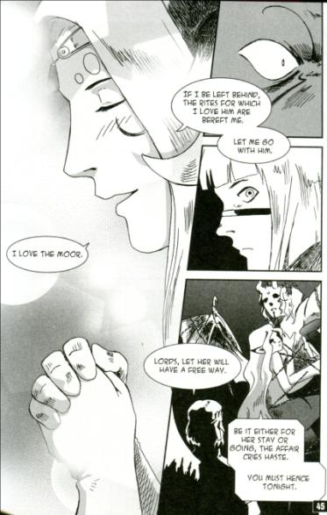
I.3.246-251
DUKE OF VENICE
What would You, Desdemona?
DESDEMONA
That I did love the Moor to live with him,
My downright violence (violation of normal standards) and storm of fortunes (disruption of my own future)
May trumpet to the world: my heart's subdued
Even to the very quality (nature) of my lord:

Slide 25
I.3.252-259
DESDEMONA
I saw Othello's visage in his mind,
And to his honour and his valiant parts (military virtues)
Did I my soul and fortunes consecrate.
So that, dear lords, if I be left behind,
A moth (idler) of peace, and he go to the war,
The rites (rites of love) for which I love him are bereft (taken away from me) me,
And I a heavy interim (sorrowful interval) shall support
By his dear absence. Let me go with him.

Slide 26
I.3.260-267
OTHELLO
Let her have your voice.
Vouch with me, heaven, I therefore beg it not
To please the palate of my appetite (sexual desire),
Nor to comply with heat the young affects (sexual appetite)
In my defunct and proper (personal) satisfaction,
But to be free (generous) and bounteous to her mind,
And heaven defend (forbid) your good souls that you think
I will your serous and great business scant
For (because) she is with me.

Slide 27
I.3.287-300
BRABANTIO
Look to her, Moor, if thou hast eyes to see:
She has deceived her father, and may thee.
Exeunt DUKE OF VENICE, Senators, Officers,
OTHELLO
My life upon her faith! Honest Iago,
My Desdemona must I leave to thee:
I prithee, let thy wife attend on her:
And bring them after in the best advantage.
Come, Desdemona: I have but an hour
Of love, of worldly matters and direction,
To spend with thee: we must obey the time.
14:43-18:40

Slide 28
Iago’s Soliloquies
Act I Scene 3. Iago speaks quite clearly: he hates Othello! His reasons?
Act II Scene 1. Iago spells out his plans for Cassio, and what he really thinks is the case (and will happen).
Act III Scene 3. Iago he plans out what he'll do with the handkerchief (a key plot element).
Act IV Scene 1. After Othello falls into his trance, Iago is alone on stage, and plans to talk to Bianca (another plot point).

Slide 29
I.3.319-335
IAGO
Virtue! a fig! (insult; often goes with a gesture) 'tis in ourselves that we are thus
or thus….
but we have reason to cool our raging motions, our carnal (physical) stings, our unbitted (forbidden) lusts, whereof I take this that you call love to be a sect (branch) or scion (shoot).
RODERIGO
It cannot be.
IAGO
It is merely a lust of the blood and a permission of
the will. Come, be a man. Drown thyself! drown
cats and blind puppies.

Slide 30
I.3.335-350
IAGO
I have professed me thy friend and I confess me knit to thy deserving with cables of perdurable (lasting) toughness; I could never better stead (benefit) thee than now. Put money in thy purse; follow thou the wars;
defeat thy favour (mood) with an usurped (false) beard; I say, put money in thy purse. It cannot be that Desdemona should long continue her love to the Moor,-- put money in thy purse,--nor he his to her: it was a violent commencement, and thou shalt see an answerable sequestration (accordingly violent separation):--put but money in thy purse. These Moors are changeable in their wills (rational intention; sexual desire): fill thy purse with money:--the food that to him now is as luscious as locusts (insect; cicadas), shall be to him shortly as bitter as coloquintida (bitter apple).

Slide 31
I.3.372-374
RODERIGO
What say you?
IAGO
No more of drowning, do you hear?
RODERIGO
I am changed: I'll go sell all my land.
Exit

Slide 32
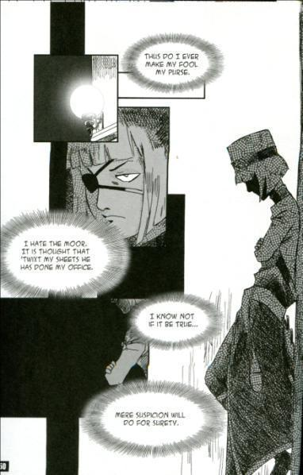
I.3.378-390
IAGO
Thus do I ever make my fool my purse:
For I mine own gain'd (hard won) knowledge should profane (abuse),
If I would time expend with such a snipe (fool).
But for my sport and profit. I hate the Moor:
And it is thought abroad (widely), that 'twixt my sheets He has done my office (make love to Emilia): I know not if't be true;

Slide 33
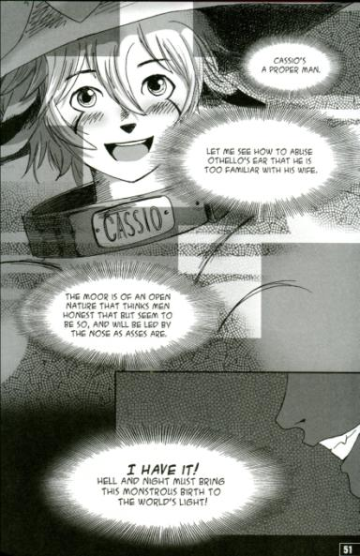
38-390
But I, for mere suspicion in that kind,
Will do as if for surety (act as it is true). He holds me well;
The better shall my purpose work on him.
Cassio's a proper (ideal) man: let me see now:
To get his place and to plume up (adorn) my will
In double knavery (double wicked)--How, how? Let's see:--

Slide 34
I.3.391-400
IAGO
After some time, to abuse Othello's ear
That he (Cassio) is too familiar with his wife. He hath a person and a smooth dispose
To be suspected, framed to make women false.
The Moor is of a free and open nature,
That thinks men honest that but seem to be so,
And will as tenderly be led by the nose
As asses are.
I have't. It is engender'd. Hell and night
Must bring this monstrous birth to the world's light.
Exit

Slide 35
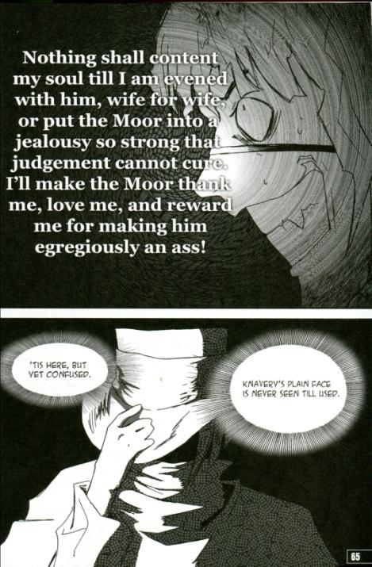
Shakespeare’s Othello
Act II Scene 1 & Act III Scene 3
Iago’s soliloquy reveals his plan and explains to the audience will happen.

Slide 36
II.1.211-218
IAGO That Cassio loves her, I do well believe ’t.
That she loves him, ’tis apt and of great credit.
The Moor, howbeit that I endure him not,
Is of a constant, loving, noble nature,
And I dare think he’ll prove to Desdemona
A most dear husband. Now, I do love her too,
Not out of absolute lust—though peradventure
I stand accountant for as great a sin—

Slide 37
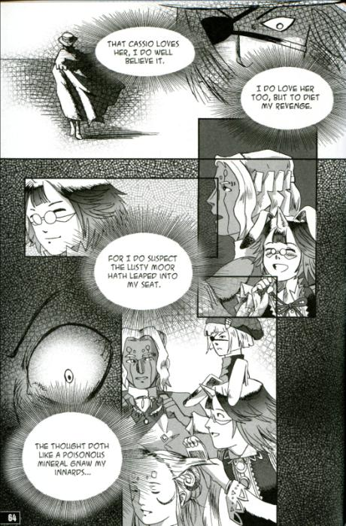
II.1.219- 224
But partly led to diet my revenge,
For that I do suspect the lusty Moor
Hath leaped into my seat. The thought whereof
Doth, like a poisonous mineral, gnaw my inwards,
And nothing can or shall content my soul
Till I am evened with him, wife for wife.

Slide 38
II.1.225-237
Or, failing so, yet that I put the Moor
At least into a jealousy so strong
That judgment cannot cure. Which thing to do,
If this poor trash of Venice, whom I trace
For his quick hunting, stand the putting on,
I’ll have our Michael Cassio on the hip,
Abuse him to the Moor in the right garb
(For I fear Cassio with my night-cape too)
Make the Moor thank me, love me, and reward me
For making him egregiously an ass
And practicing upon his peace and quiet
Even to madness. 'Tis here, but yet confused.
Knavery’s plain face is never seen till used.

Slide 39
III.3.127-133
IAGO
For Michael Cassio,
I dare be sworn I think that he is honest.
OTHELLO
I think so too.
IAGO
Men should be what they seem;
Or those that be not, would they might seem none! ( wish they won’t look so)
OTHELLO
Certain, men should be what they seem.
IAGO
Why, then, I think Cassio's an honest man.

Slide 40
III.3.134-147
OTHELLO
Nay, yet there's more in this:
I prithee, speak to me as to thy thinkings,
As thou dost ruminate, and give thy worst of thoughts
The worst of words.
IAGO
Good my lord, pardon me:
Though I am bound to every act of duty,
I am not bound to that all slaves are free to.
Utter my thoughts? Why, say they are vile and false;
As where's that palace whereinto foul things
Sometimes intrude not? who has a breast so pure,
But some uncleanly apprehensions (thoughts)
Keep leets (court records) and law-days (legal holidays) and in session sit
With meditations lawful (lawful deliberation)? (Bad guys do exist)

Slide 41
III.3.148-156
OTHELLO
Thou dost conspire against thy friend, Iago,
If thou but think'st him wrong'd and makest his ear
A stranger to thy thoughts. (don’t tell your friend the truth)
IAGO
I do beseech you--
Though I perchance am vicious in my guess,
As, I confess, it is my nature's plague (bad habit)
To spy into abuses (wrong), and oft my jealousy
Shapes faults that are not--that your wisdom yet,
From one that so imperfectly conceits,
Would take no notice, nor build yourself a trouble
Out of his scattering (scattered) and unsure observance.
It were not for your quiet (peace) nor your good (wellbeing),
Nor for my manhood, honesty, or wisdom,
To let you know my thoughts. (your wisdom will not notice from one who imperfectly imagine things)

Slide 42
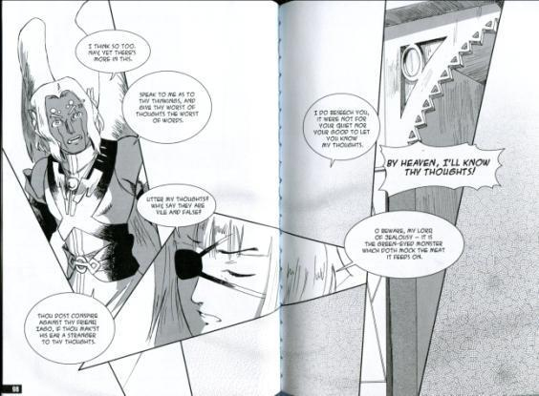
III.3.168-178
Skip to line 168
IAGO
O, beware, my lord, of jealousy;
It is the green-eyed monster which doth mock
The meat it feeds on; that cuckold (deceived) lives in bliss
Who, certain of his fate, loves not his wronger;
But, O, what damned minutes tells he o'er
Who dotes, yet doubts, suspects, yet strongly loves!
OTHELLO
O misery!

Slide 43
III.3.179-195
IAGO
Poor and content is rich and rich enough,
But riches fineless (endless riches) is as poor as winter
To him that ever fears he shall be poor.
OTHELLO
Why, why is this?
Think'st thou I'ld make a lie of jealousy,
To follow still the changes of the moon
With fresh suspicions? No; to be once in doubt
Is once to be resolved: …

Slide 44
III.3.196-207
IAGO
I am glad of it; for now I shall have reason
To show the love and duty that I bear you
With franker spirit: therefore, as I am bound,
Receive it from me. I speak not yet of proof.
Look to your wife; observe her well with Cassio;
Wear your eye thus, not jealous nor secure:
I would not have your free and noble nature,
Out of self-bounty (generosity), be abused; look to't:
I know our country disposition (atmosphere) well;
In Venice they do let heaven see the pranks (tricks; mischief)
They dare not show their husbands; their best conscience
Is not to leave't undone, but keep't unknown.

Slide 45
III.3.208-215
OTHELLO:
Dost thou say so?
IAGO:
She did deceive her father, marrying you;
And when she seem'd to shake and fear your looks,
She loved them most. (she loves you most when you are in anger)
OTHELLO
And so she did.
IAGO
Why, go to then;…(think about it then)
I humbly do beseech you of your pardon
For too much loving you.

Slide 46
III.3.328-334
EMILIA If it be not for some purpose of import,
Give ’t me again. Poor lady, she’ll run mad
When she shall lack it (handkerchief).
IAGO Be not acknown on ’t,
I have use for it. Go, leave me
Exit EMILIA
I will in Cassio’s lodging lose this napkin
And let him find it. Trifles light as air
Are to the jealous confirmations strong
As proofs of holy writ. This may do something.

Slide 47
III.3.328-336
IAGO
The Moor already changes with my poison:
Dangerous conceits (imaginings) are, in their natures, poisons. Which at the first are scarce found to distaste, (to be unpleasant)
But with a little act (action) upon the blood.
Burn like the mines of sulphur. ( i.e. hell) I did say so:
Look, where he comes!
Re-enter OTHELLO
Not poppy, (opium, derived from the poppy) nor mandragora, (a narcotic deriving from the mandrake plant)
Nor all the drowsy syrups (soporific drugs) of the world,
Shall ever medicine (drug) thee to that sweet sleep
Which thou owedst (enjoyed) yesterday.
OTHELLO
Ha! ha! false to me?
IAGO
Why, how now, general! no more of that.

Slide 48
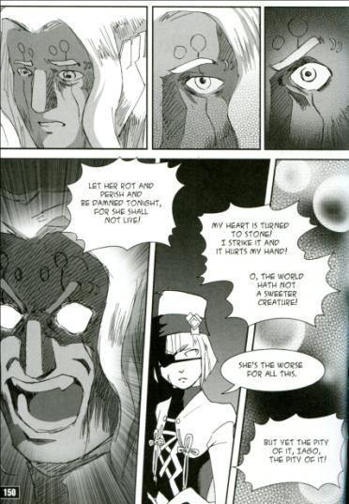
Shakespeare’s Othello
Act IV Scene 1
Iago is going to implement his plan. Will Othello fall into his trap?
Manga Shakespeare Othello, illustrated by Ryuta Osada

Slide 49
IV.1.1-9
IAGO Will you think so?
OTHELLO Think so, Iago?
IAGO What,
To kiss in private?
OTHELLO An unauthorized kiss!
IAGO Or to be naked with her friend in bed
An hour or more, not meaning any harm?
OTHELLO Naked in bed, Iago, and not mean harm!
It is hypocrisy against the devil.
They that mean virtuously, and yet do so,
The devil their virtue tempts, and they tempt heaven.

Slide 50
IV.1.10-17
IAGO
But if I give my wife a handkerchief,--
OTHELLO
What then?
IAGO
Why, then, 'tis hers, my lord; and, being hers,
She may, I think, bestow't on any man.
OTHELLO
She is protectress of her honour too:
May she give that?
IAGO
Her honour is an essence (spiritual entity) that's not seen;
They have it very oft that have it not: (i.e. are credited with honour although they have lost it)
But for the handkerchief—

Slide 51
IV.1.25-31
IAGO
What,
If I had said I had seen him do you wrong?
Or heard him say,--as knaves be such abroad, (as there are such villains about)
Who having, by their own importunate (demanding) suit,
Or voluntary dotage (willing infatuation) of some mistress,
Convinced (overcome) or supplied (sexually satisfied) them, cannot choose
But they must blab—
OTHELLO
Hath he said any thing?
IAGO
He hath, my lord; but be you well assured,
No more than he'll unswear.

Slide 52
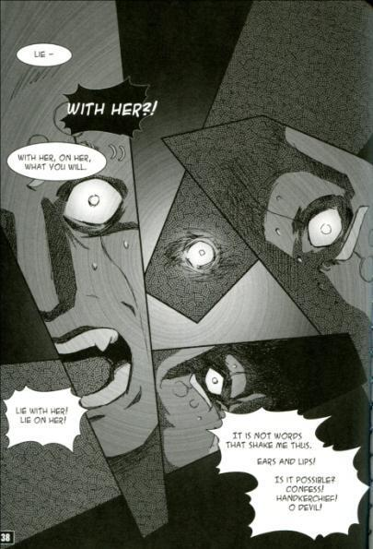
IV.1.32-37
OTHELLO
What hath he said?
IAGO
'Faith, that he did--I know not what he did.
OTHELLO
What? what?
IAGO
Lie—
OTHELLO
With her?
IAGO
With her, on her; what you will.

Slide 53
IV.1.38-42
OTHELLO
Lie with her! lie on her! We say lie on her, when
they belie (slander) her. Lie with her! that's fulsome (disgusting).
--Handkerchief--confessions--handkerchief!--To
confess, and be hanged for his labour;--first, to be hanged, and then to confess (not a proper procedure before an execution).
A word play on “Lie” and “belie”

Slide 54
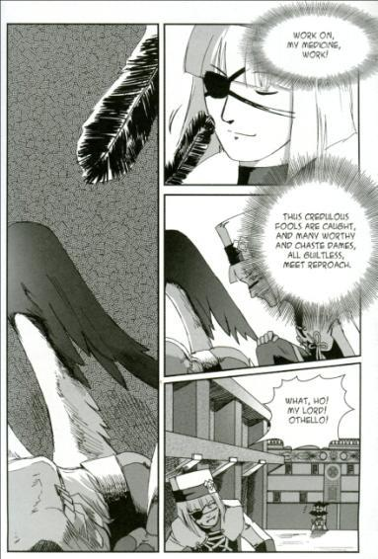
IV.1.43
OTHELLO I tremble at it.
Nature would not invest herself in such shadowing
passion without some instruction. It is not words that shake me thus. Pish! Noses, ears, and lips (Othello may be thinking that their noses and lips may have touched in kissing and their ears have been close together for whispering). --Is't possible?--Confess--handkerchief!--O devil!--
[Falls in a trance]

Slide 55
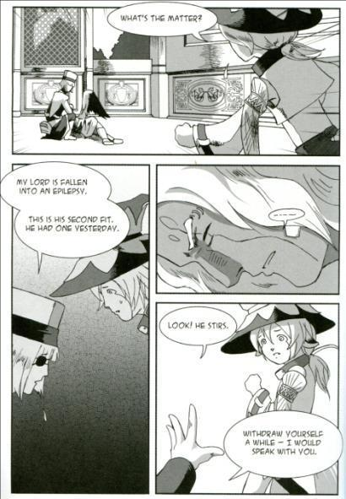
IV.1.44-52
IAGO
Work on,
My medicine, work! Thus credulous fools are caught;
And many worthy and chaste dames even thus,
All guiltless, meet reproach (shame). What, ho! my lord! My lord, I say! Othello!
Enter CASSIO
How now, Cassio!
CASSIO
What's the matter?

Slide 56
IV.1.53-59
IAGO
My lord is fall'n into an epilepsy:
This is his second fit; he had one yesterday.
CASSIO
Rub him about the temples.
IAGO
No, forbear (control yourself);
The lethargy (coma, unconsciousness) must have his quiet course:
If not, he foams at mouth and by and by
Breaks out to savage madness. Look he stirs:
Do you withdraw yourself a little while,
He will recover straight: when he is gone,
I would on great occasion (about a serious) speak with you.
Exit CASSIO

Slide 57
IV.1.66/78-83
IAGO
Good sir, be a man; SKIP
Cassio came hither: I shifted him away, (got rid of him by stratagem)
And laid good scuse (made a good excuse of) upon your ecstasy, (fit, trance)
Bade him anon (immediately) return and here speak with me;
The which he promised. Do but encave (conceal) yourself,
And mark the fleers, (mocks) the gibes, and notable (obvious) scorns,
That dwell in every region of his face;

Slide 58
IV.1.84-87/94-96
IAGO
For I will make him tell the tale anew,
Where, how, how oft, how long ago, and when
He hath, and is again to cope (encounter, copulate wih) your wife:
I say, but mark his gesture. (behaviour) Marry, patience. But—dost thou hear?—most bloody.
IAGO That’s not amiss,
But yet keep time in all. Will you withdraw?
OTHELLO withdraws
Now will I question Cassio of (about; lago explains his tactics to the audience) Bianca,
A housewife (hussy (pronounced ‘huswif’)) that by selling her desires (sexual desires)

Slide 59
IV.1.98-105
IAGO
He, when he hears of her, cannot refrain
From the excess of laughter. Here he comes.
Re-enter CASSIO
As he shall smile, Othello shall go mad;
And his unbookish (ignorant) jealousy must construe (interpret)
Poor Cassio's smiles, gestures and light (cheerful) behavior,
Quite in the wrong. How do you now, lieutenant?
CASSIO
The worser that you give me the addition (title)
Whose want (the lack of which) even kills me.

Slide 60
IV.1.106-110
IAGO
Ply (get along well with) Desdemona well, and you are sure on't.
Speaking lower
Now, if this suit lay in Bianco's power,
How quickly should you speed (prosper)!
CASSIO
Alas, poor caitiff! (wretch (affectionate))
OTHELLO
Look, how he laughs already!
IAGO
I never knew woman love man so.

Slide 61
IV.1.111-117
CASSIO
Alas, poor rogue! I think, i' faith, she loves me.
OTHELLO
Now he denies it faintly (lightly), and laughs it out.
IAGO
Do you hear, Cassio?
OTHELLO
Now he importunes (entreats) him
To tell it o'er: go to; well said (done), well said.
IAGO
She gives it (tells people) out that you shall marry hey:
Do you intend it?

Slide 62
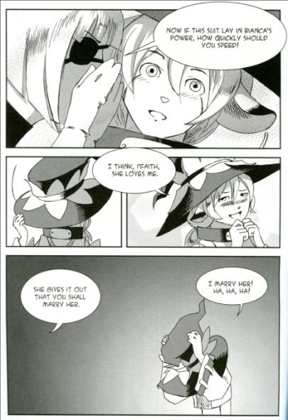
IV.1.118-123
CASSIO
Ha, ha, ha!
OTHELLO
Do you triumph, Roman (conqueror)? Do you triumph?
CASSIO
I marry her! what? A customer (whore)! Prithee, bear some charity to my wit: (think better of my judgment) do not think it so unwholesome (unhealthy, feeble) .
Ha, ha, ha!

Slide 63
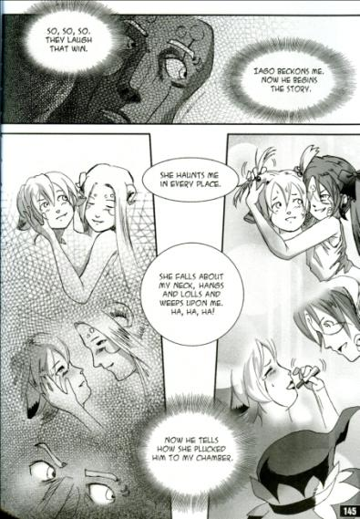
IV.1.131-136
OTHELLO
Iago beckons me; now he begins the story.
CASSIO
She was here even now (just now); she haunts me in every place. I was the other day talking on the sea-bank with certain Venetians; and thither comes the bauble (plaything), and, by this hand, she falls me thus about my neck—(throws her arms round my neck)

Slide 64
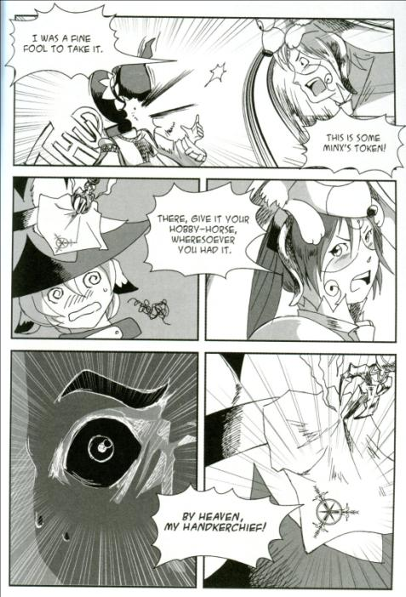
IV.1.147-156
BIANCA
I was a fine fool to take it. I must take out (copy) the work?--A likely piece of work (story), that you should find it in your chamber, and not know who left it there! This is some minx's token, and I must take out the work? There; give it your hobby-horse (whore): wheresoever you had it, I'll take out no work on't.

Slide 65
IV.1.153-156
CASSIO
How now, my sweet Bianca! how now! how now!
OTHELLO
By heaven, that should (must) be my handkerchief!
Exit

Slide 66
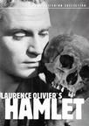
Shakespeare’s Hamlet
Laurence Olivier’s Hamlet (1948)
You may watch it online now:
http://viooz.co/movies/9584-hamlet-1948.html
http://bardolatry.com/2010/01/hamlet-1948-directed-by-and-starring-laurence-olivier/

Slide 67
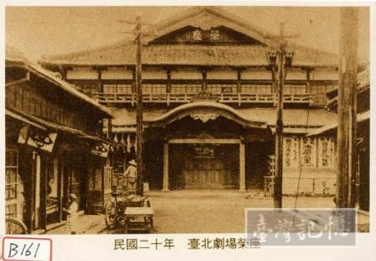
Japanese Hamlet
Yamagishi Kayô and Dohi Shunsho’s adaptation of Hamlet (1903) came to perform at Taihoku-za in Taiwan in 1905. This Japanese adaptation was performed in Sakae-za in 1908.

Slide 68
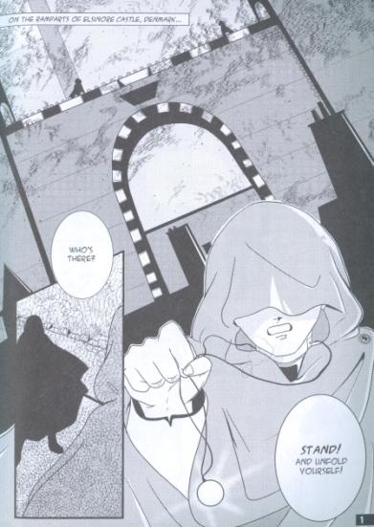
Hamlet’s Plot
Hamlet tells a tragedy set in Kingdom of Denmark. Hamlet, the son of the recently deceased King Hamlet suspects that his father’s death is associated with the present King, Claudius, his father's brother and his uncle. One day, Hamlet is told, the ghost of his father returns.

Slide 69

The Kabuki Revenge
Play
Kabuki Kanadehon Chusingura
The samurai Oboshi Yuranosuke takes revenge for his lord’s death.
http://www.amazon.com/Kabuki-Theatre-Chushingura-Onoe-Shoroku/dp/B000I0RNCK

Slide 70
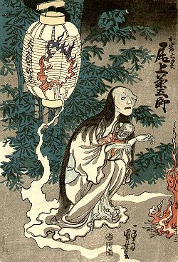
Oiwa in Tōkaidō Yotsuya Kaidan
Oiwa in Tōkaidō Yotsuya Kaidan, woodblock print by Utagawa Kuniyoshi (ca. 1845-1846)

Slide 71
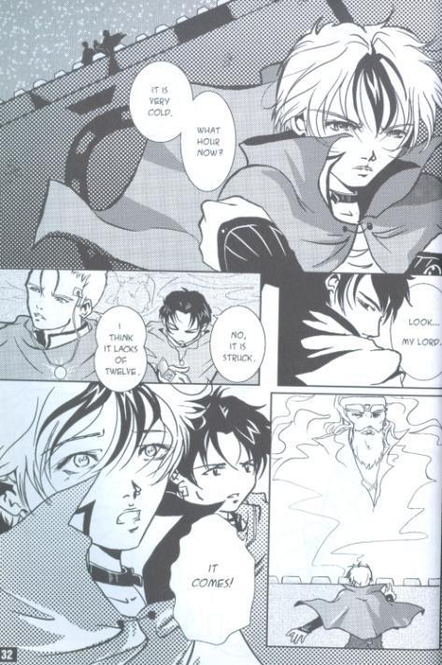
Manga Shakespeare Hamlet, illustrated by Emma Vieceli
Horatio once confronts the ghost,
“What art thou that usurp'st this time of night,
Together with that fair and warlike form
In which the majesty of buried Denmark
Did sometimes march? by heaven I charge thee, speak!”

Slide 72
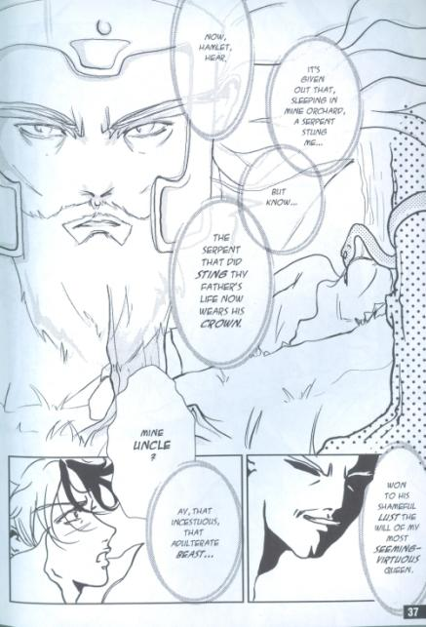
I.2.235-245
HAMLET Arm'd, say you?
MARCELLUS BERNARDO Arm'd, my lord.
HAMLET From top to toe?
MARCELLUS BERNARDO My lord, from head to foot.
HAMLET Then saw you not his face?
HORATIO O, yes, my lord; he wore his beaver up.
HAMLET What, look'd he frowningly?
HORATIO A countenance more in sorrow than in anger.
HAMLET Pale or red?
HORATIO Nay, very pale.

Slide 73
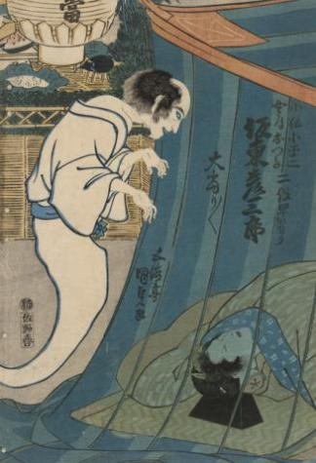
The Japanese ghost
Utagawa Kunisada’s woodblock print features the Kabuki actor, Bando Hikosaburo (1830) in two roles: The ghost of Kohada Koheiji and his sleeping wife Otawa in Iroiri Otogigusa
http://www.ngv.vic.gov.au/ngvschools/FloatingWorld/supernatural/The-actor-Bando-Hikosaburo-in-two-roles-The-ghost-of-Kohada-Koheiji-and-his-sleeping-wife-Otawa-in-the-play-Iroiri-Otogigusa/

Slide 74
The ghost in Kanagaki Robun’s Hamuretto Yamato Nishikie. Tokyo Eiri Shinbun (October 19th, 1886).

Slide 75
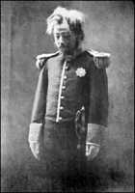
Kawakami Otojirô’s Hamlet
Kawakami Otojirô played the ghost of King Hamlet in Hamlet.
http://elsinore.ucsc.edu/Ghost/ghostHistory.html

Slide 76
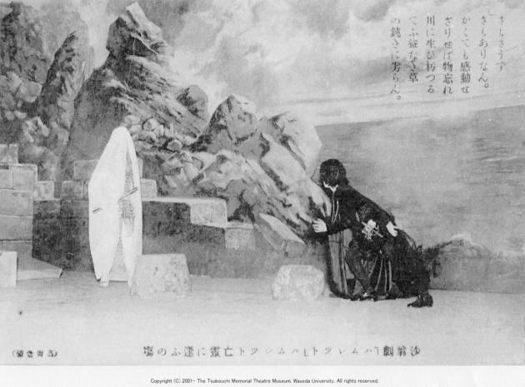
The ghost in Tsubouchi Shôyô’s Hamlet
The ghost in Tsubouchi Shôyô’s Hamlet, performed in 1911 at the Tokyo Imperial Theatre
Courtesy to the Waseda University Tsubouchi Memorial Theatre Museum

Slide 77
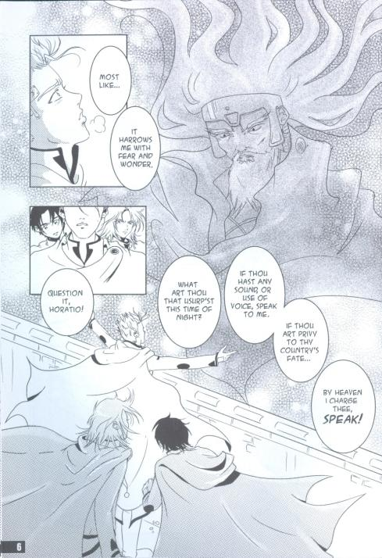
Shakespeare’s Hamlet the Ghost
Manga Shakespeare Hamlet, illustrated by Emma Vieceli

Slide 78
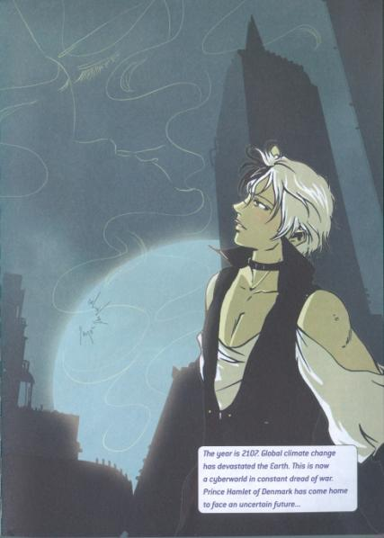
Characters
Horatio–Friend to Hamlet
Marcellus–an Officer
Bernardo–an Officer
Francisco–a Soldier
Ghost of Hamlet's Father

Slide 79
I.1.27-34
Ber. Welcome, Horatio; welcome, good Marcellus.
Mar./Har. What! has this thing (Shakespeare begins to build up suspense.) appear’d again to-night?
Ber. I have seen nothing.
Mar. Horatio says ’tis but our fantasy (just our imagination),
And will not let belief take hold of him
Touching this dreaded (dreadful) sight twice seen of us:
Therefore (that is why. The audience needs to be told this— Barnardo already knows.) I have entreated him along (to come along)
With us to watch the minutes of this night;

Slide 80
I.1.49-55
Enter Ghost.
Mar. Peace! break thee off; look, where it comes again!
Ber. In the same figure (shape) , like the king that’s dead.
Mar. Thou art a scholar (Horatio would know Latin, the proper language in which to address any supernatural being although theatrical convention permits English here.) ; speak to it, Horatio.
Ber. Looks it not like the king? mark it, Horatio.
Hor. Most like: it harrows me (breaks me up) with fear and wonder.
Ber. It would (wants to be. A ghost could not start a conversation.) be spoke to.
Mar. Question it, Horatio.

Slide 81
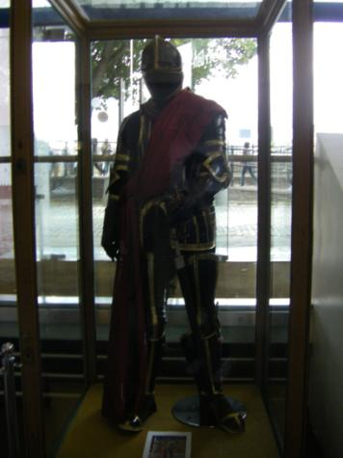
I.1.56-59
Hor. What art thou that usurp’st (Haratio challenges the Ghost’s right to appear at that time and in that particular shape.) this time of night,
Together with that fair and war-like (martial) form
In which the majesty of buried Denmark (dead king of Denmark.)
Did sometimes march? by heaven I charge thee, speak!

Slide 82
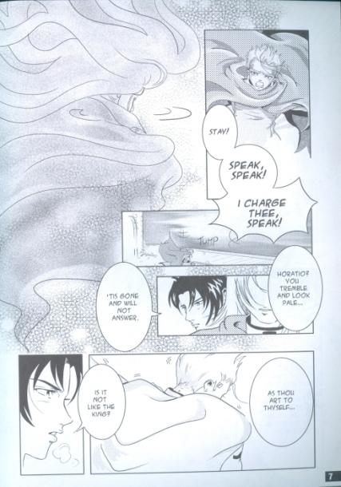
I.1.60-62
Mar. It is offended.
Ber. See! it stalks away.
Hor. Stay! speak, speak! I charge thee, speak! [Exit Ghost.
Mar. ’Tis gone, and will not answer.
Ber. How now, Horatio! you tremble and look pale:
Is not this something more than fantasy?
What think you on ’t?

Slide 83

I.4.42-47
Enter GHOST.
Hor. Look, my lord, it comes.
Ham. Angels and ministers of grace defend us!
Be thou a spirit of health or goblin damn’d,
Bring with thee airs from heaven or blasts from hell,
Be thy intents wicked or charitable,

Slide 84
I.4.48-55
Ham. Thou com’st in such a questionable shape (appearance which invites questioning)
That I will speak to thee: I’ll call thee Hamlet
King, father; royal Dane, O! answer me:
Let me not burst in ignorance; but tell
Why thy canoniz’d bones (body which has been buried properly), hearsed (coffined) in death,
Have burst their cerements (shroud); why the sepulchre (tomb),
Wherein we saw thee quietly inurn’d, (placed in the funeral urn.)
Hath op’d his ponderous (heavy) and marble jaws,
To cast thee up again. What may this mean,

Slide 85
I.4.56-61
Ham. That thou, dead corse, again in complete steel (full armour.)
Revisit’st thus the glimpses of the moon, (fitful moonlight)
Making night hideous (terrifying); and we fools of nature
So horridly to shake our disposition (nature)
With thoughts beyond the reaches of our souls?
Say, why is this? wherefore? what should we do? (what…do: Hamlet assumes that the Ghost will demand some action.) [The Ghost beckons HAMLET.

Slide 86
I.5.1-9
Enter Ghost and HAMLET.
Ham. Whither wilt thou lead me? speak; I’ll go no further.
Ghost. Mark me.
Ham. I will.
Ghost. My hour is almost come,
When I to sulphurous and tormenting flames (the fires of Purgatory.)
Must render up myself.
Ham. Alas! poor ghost.
Ghost. Pity me not, but lend thy serious hearing
To what I shall unfold.

Slide 87
I.5.40-46
Ghost. Now, Hamlet, hear:
Tis given out that, sleeping in mine orchard, (garden)
A serpent stung me; so the whole ear of Denmark (the …Denmark: everyone in Denmark who heard this.)
Is by a forged process (false account) of my death
Rankly abus’d; but know, thou noble youth,
The serpent that did sting thy father’s life
Now wears his crown.
Ham. O my prophetic soul! (I knew it!)
My uncle!

Slide 88
I.5.47-55
Ghost. Ay, that incestuous, that adulterate (adulterous) beast,
With witchcraft of his wit, with traitorous gifts,—
O wicked wit and gifts, that have the power
So to seduce!—won to his shameful lust
The will of my most seeming-virtuous queen.
O Hamlet! what a falling-off was there;
From me, whose love was of that dignity (so honourable)
That it went hand in hand even with the vow
I made to her in marriage; and to decline (descend to the level of)

Slide 89
III.4.122-128
Ghost. Do not forget (Once again (see 1,5, 99) the Ghost stirs Hamlet’s memory): this visitation
Is but to whet (sharpen (like a knife).) thy almost blunted purpose.
But, look! amazement (bewilderment. Gertrude is unaware of the Ghost’s presence.) on thy mother sits;
O! step between her and her fighting soul;
Conceit (imagination) in weakest bodies strongest works:
Speak to her, Hamlet.
Ham. How is it with you, lady?

Slide 90
III.4.129-137
Queen. Alas! how is’t with you,
That you do bend your eye (fix your gaze) on vacancy
And with the incorporal (empty) air do hold discourse?
Forth at your eyes your spirits wildly peep (Forth…peep: your eyes stare wildly.);
And, as the sleeping soldiers in the alarm (when the alarm is sounded.),
Your bedded hair, like life in excrements (outgrowths (which have no life in them).),
Starts up and stands an (on) end. O gentle son!
Upon the heat and flame of thy distemper
Sprinkle cool patience. Whereon do you look?

Slide 91
III.4.138-143
Ham. On him, on him! Look you, how pale he glares!
His form and cause (his appearance and the reason he has for appearing.) conjoin’d (joined together), preaching to stones,
Would make them capable (sensible, able to respond). Do not look upon me;
Lest with this piteous action (movement) you convert
My stern effects (purposes): then what I have to do
Will want true colour (not look right—be done for the wrong reason.); tears perchance for blood (tears…blood: perhaps tears will be shed rather than blood.).

Slide 92
III.4.144-151
Queen. To whom do you speak this?
Ham. Do you see nothing there?
Queen. Nothing at all; yet all that is I see.
Ham. Nor did you nothing hear?
Queen. No, nothing but ourselves.
Ham. Why, look you there! look, how it steals away;
My father, in his habit as he liv’d (wearing the clothes he wore when alive.);
Look! where he goes, even now, out at the portal (doorway). [Exit Ghost.

Slide 93
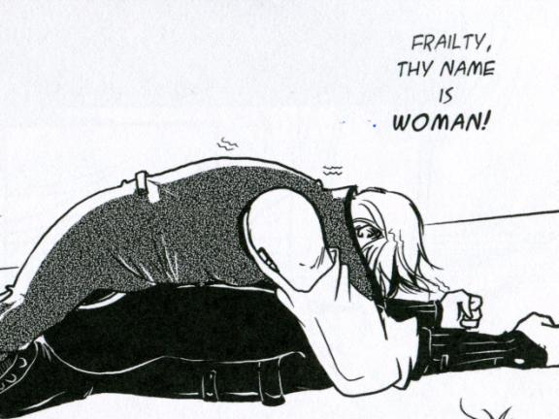
Manga, Comics and Graphic Novels Hamlet
Manga Shakespeare Hamlet, illustrated by Emma Vieceli

Slide 94
Manga, Comics and Graphic Novels
Terms:
Comics: It’s a form which is composed of text and images to express ideas in sequential panels.
Graphic Novels: A book is made up of comics contents.
Manga: It’s used to refer to comics created in Japan, but nowadays it could mean the comics which are illustrated to conform to a style developed in Japan.

Slide 95
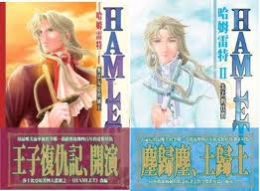
Hamlet
At least three graphic novels of Hamlet on the Taiwanese market:
Meng Chen’s shôjo manga series of Hamlet (2006);
Lai Youxien and Wu Chun’s Wangzi Fuchouji [The Prince’s Revenge] (2011);
Manhua Shashibiya: Hamulete (2012).
Meng Chen’s shôjo manga series of Hamlet (2006)

Slide 96
Hamlet’s Plot
Prince Hamlet of Denmark, son of the recently deceased King Hamlet witnesses his father's brother, Claudius, becomes the king. Claudius hastily married Hamlet's mother, Gertrude.
Hamlet sees his father’s ghost, who tells him that he is murdered by Claudius.
What would you do if you were Hamlet?

Slide 97
I.2.131-139
Hamlet
O that this too too solid flesh would melt,
Thaw, and resolve itself into a dew!
Or that the Everlasting had not fix'd
His canon 'gainst self-slaughter! O God! O God!
How weary, stale, flat, and unprofitable
Seem to me all the uses of this world!
Fie on't! O fie! 'tis an unweeded garden,
That grows to seed; things rank and gross in nature
Possess it merely. That it should come to this!

Slide 98
I.2.140-146
Hamlet
But two months dead! — nay, not so much, not two:
So excellent a king; that was, to this,
Hyperion to a satyr; so loving to my mother,
That he might not beteem the winds of heaven
Visit her face too roughly. Heaven and earth!
Must I remember? Why, she would hang on him
As if increase of appetite had grown

Slide 99
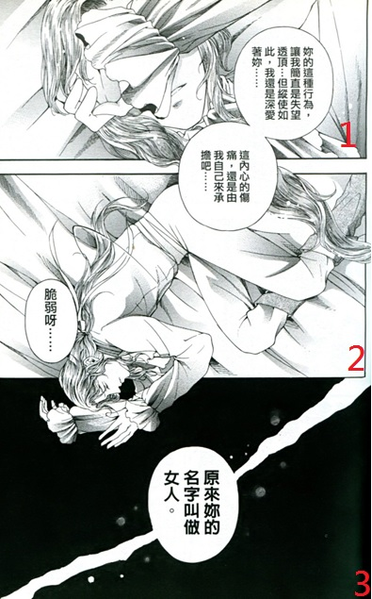
I.2.147-155
Meng Chen’s Hamlet (2006); Frailty, thy name is woman!—
Hamlet
By what it fed on, and yet, within a month—
Let me not think on ’t. Frailty, thy name is woman!—
A little month, or ere those shoes were old
With which she followed my poor father’s body,
Like Niobe, all tears. Why she, even she—

Slide 100
I.2.156-161
O God, a beast that wants discourse of reason
Would have mourned longer!—married with my uncle,
My father’s brother, but no more like my father
Than I to Hercules: within a month;
Ere yet the salt of most unrighteous tears
Had left the flushing in her galled eyes,
She married: — O, most wicked speed, to post
With such dexterity to incestuous sheets!
It is not, nor it cannot come to good;
But break my heart, — for I must hold my tongue!

Slide 101
Hamlet (II.2.74-83)
HAMLET
…I have of late—but wherefore I know not—lost all my mirth, forgone all custom of exercises, and indeed it goes so heavily with my disposition that this goodly frame, the earth, seems to me a sterile promontory; this most excellent canopy, the air—look you, this brave o'erhanging firmament, this majestical roof fretted with golden fire—why, it appears no other thing to me than a foul and pestilent congregation of vapors…

Slide 102
II.2.84-92
HAMLET
What a piece of work is a man! How noble in reason, how infinite in faculty! In form and moving how express and admirable! In action how like an angel, in apprehension how like a god! The beauty of the world. The paragon of animals. And yet, to me, what is this quintessence of dust? Man delights not me. No, nor woman neither, though by your smiling you seem to say so.

Slide 103
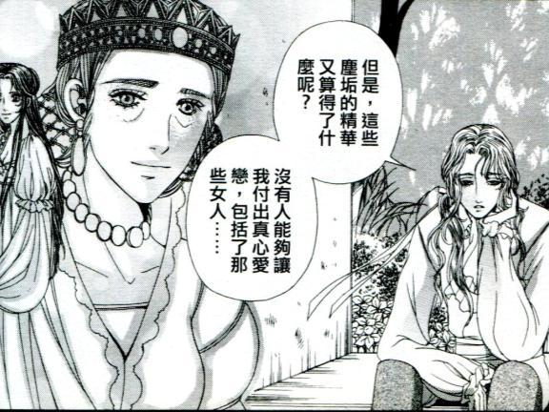
Meng Chen’s Hamlet (2006): A chat with Rosencrantz and Guildenstern (II.2)
Hamlet: However, what is the essence of dust to me? No one can win my devotion, including those women.

Slide 104
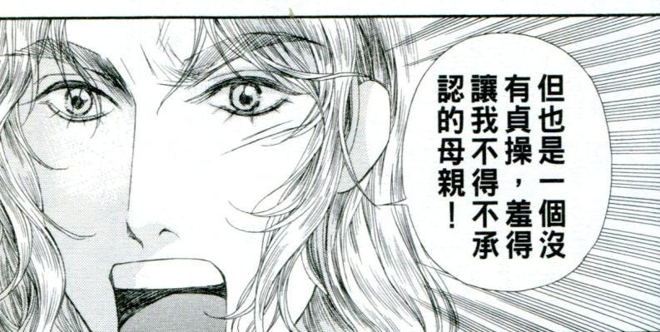
Meng Chen’s Hamlet (2006); Hamlet’s chamber scene III.4
Hamlet: But [you are] also a dishonest mother I’m so ashamed to admit.

Slide 105
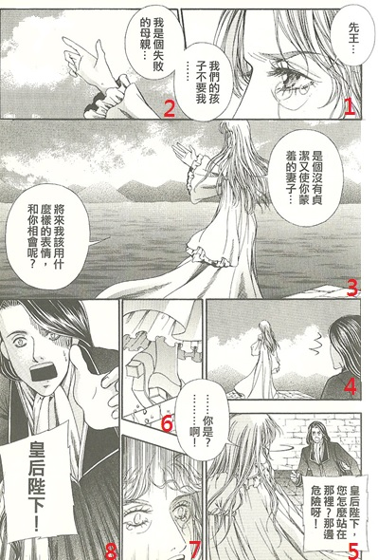
Meng Chen’s Hamlet (2006)
Gertrude must Die
Gertrude (Panel 1 & 2):
The late King, our child doesn’t want me…
I’ve failed as a mother.
Gertrude (Panel 3): An unchaste wife who brings shame on you…What do I have a face to see you?
(Panel 5)
Horatio: Your Majesty, why are you standing there? It’s dangerous!
Gertrude:..You are?...Ah!”
(Panel 8) Horatio: “Your Majesty!”

Slide 106
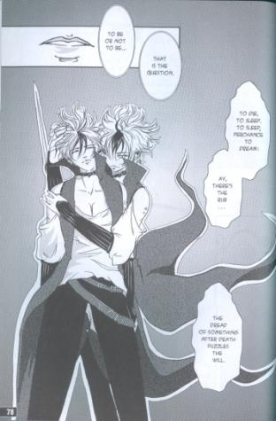
Shakespeare’s Hamlet
Act III Scene 1
Manga Shakespeare Hamlet, illustrated by Emma Vieceli

Slide 107
III.1.63-67
Ham.
To be, or not to be (live, exist): that is the question:
Whether ’tis nobler in the mind to suffer
The slings and arrows of outrageous (wilful) fortune,
Or to take arms against a sea of troubles,
And by opposing end them? (take…them: fight against trouble.) To die: to sleep;
Hamlet’s famous soliloquy:
Please count how many syllables in one line.
Is his soliloquy rhymed?
Is it a rhymed verse, iambic pentameter, or prose?
Which words will you put the stress?
What does the rhythm tell us about Hamlet’s status of mind?

Slide 108
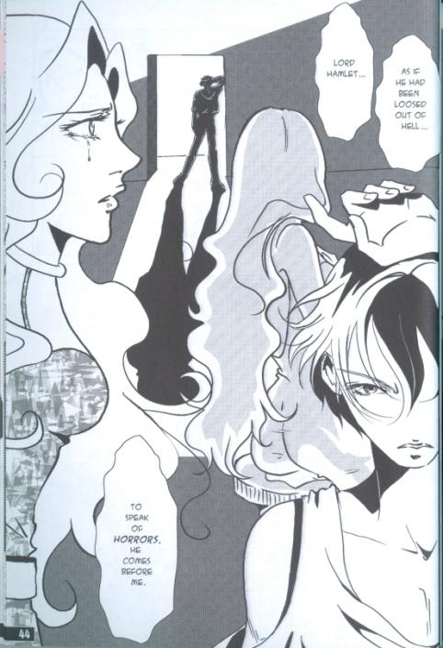
II.1.97-101
Ophelia
He took me by the wrist and held me hard,
Then goes he to the length of all his arm,
And, with his other hand thus o’er his brow,
He falls to such perusal of my face
As he would draw it. Long stay’d he so;

Slide 109
II.1.107-110
That done, he lets me go,
And, with his head over his shoulder turn’d,
He seem’d to find his way without his eyes;
For out o’ doors he went without their help,
And to the last bended their light on me.

Slide 110
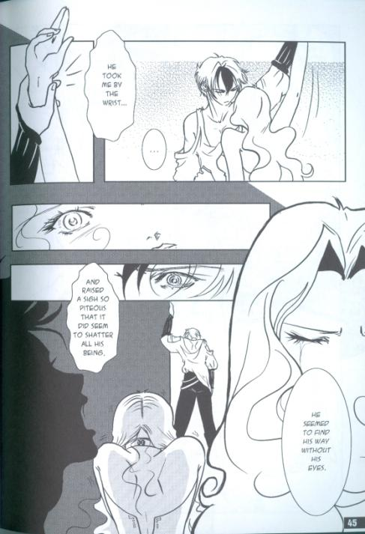
II.1.102-106
At last, a little shaking of mine arm,
And thrice his head thus waving up and down,
He rais’d a sigh so piteous and profound
That it did seem to shatter all his bulk
And end his being.

Slide 111
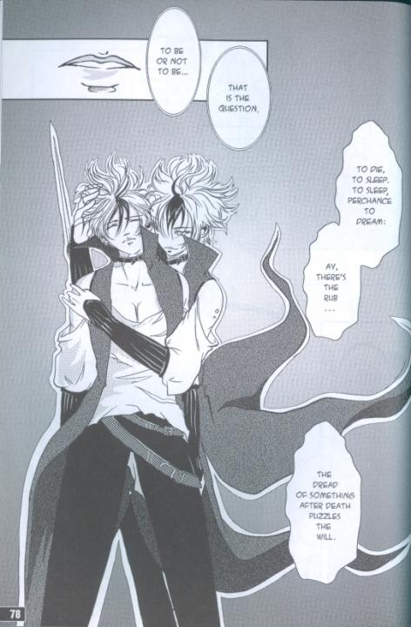
III.1.63-67
Ham.
To be, or not to be (live, exist): that is the question:
Whether ’tis nobler in the mind to suffer
The slings and arrows of outrageous (wilful) fortune,
Or to take arms against a sea of troubles,
And by opposing end them? (take…them: fight against trouble.) To die: to sleep;

Slide 112
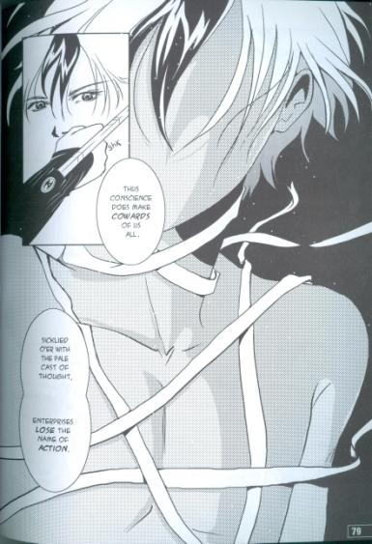
III.1.68-71
No more (that is all); and, by a sleep to say we end
The heart-ache and the thousand natural shocks
That flesh is heir to, ’tis a consummation (final completion)
Devoutly to be wish’d. To die, to sleep; (if we could end the heartaches and sufferings)

Slide 113
III.1.72-76
Ham.
To sleep: perchance to dream: ay, there’s the rub
For in that sleep of death what dreams may come
When we have shuffled off (got free from) this mortal coil (business of humanity),
Must give us pause (make us stop to think). There’s the respect
That makes calamity of so long life;
rub (snag; in the game of bowls, the ‘rub’ is anything that impedes the bowl’s movement.);
That makes calamity of so long life; (There’s…life: that’s why misfortune endures so long.)

Slide 114
III.1.77-81
Ham. For who would bear the whips and scorns of time (this temporal world) ,
The oppressor’s wrong (tyrant’s injustice), the proud man’s contumely (arrogance),
The pangs of dispriz’d (unrequited) love, the law’s delay,
The insolence of office, and the spurns (disdain)
That patient merit (the meritorious man) of (from) the unworthy takes,

Slide 115
III.1.82-86
When he himself might his quietus (final reckoning) make
With a bare bodkin (needle, small dagger)? who would fardels (burdens) bear,
To grunt and sweat under a weary life,
But that the dread of something after death,
The undiscover’d country (unexpected territory) from whose bourn (frontier)
No traveller returns,

Slide 116
III.1.87-93
Ham. puzzles the will,
And makes us rather bear those ills we have
Than fly to others that we know not of?
Thus conscience (consciousness, moral awareness) does make cowards of us all;
And thus the native hue of resolution (native…resolution: natural colour of courage.)
Is sicklied o’er with the pale cast of thought, (sicklied…thought: turned white with the pallor of thinking.)

Slide 117
III.1.94-100
Ham. And enterprises of great pith (magnitude) and moment (importance)
With this regard their currents turn awry,
And lose the name of action. Soft you now! (be quiet)
The fair Ophelia! Nymph, in thy orisons (prayers)
Be all my sins remember’d.

Slide 118
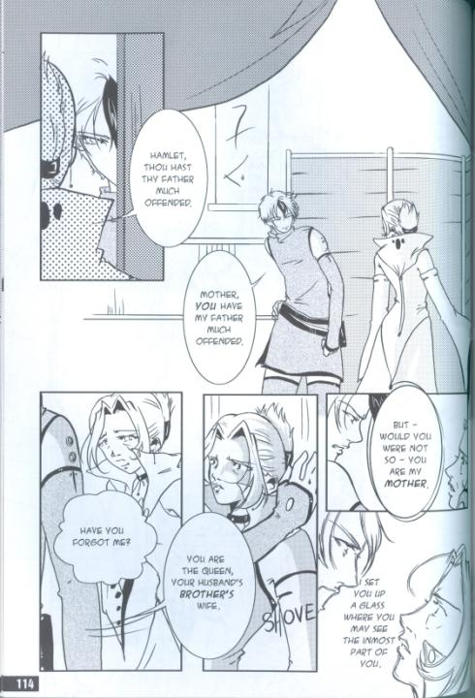
Shakespeare’s Hamlet
Act III Scene 4
Manga Shakespeare Hamlet, illustrated by Emma Vieceli

Slide 119
III.4.8-13
POLONIUS hides behind the arras
Enter HAMLET
HAMLET Now, mother, what's the matter?
GERTRUDE Hamlet, thou hast thy father much offended.
HAMLET Mother, you have my father much offended.
GERTRUDE Come, come, you answer with an idle tongue.
HAMLET Go, go, you question with a wicked tongue.
GERTRUDE Why, how now, Hamlet!

Slide 120
III.4.14-22
HAMLET What's the matter now?
GERTRUDE Have you forgot me?
HAMLET No, by the rood, not so:
You are the queen, your husband's brother's wife;
And--would it were not so!--you are my mother.
GERTRUDE Nay, then, I'll set those to you that can speak.
HAMLET Come, come, and sit you down; you shall not budge;
You go not till I set you up a glass
Where you may see the inmost part of you.

Slide 121
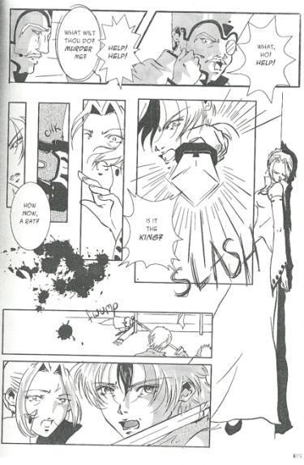
III.4.23-26
GERTRUDE What wilt thou do? thou wilt not murder me?
Help, help, ho!
POLONIUS [Behind] What, ho! help, help, help!
HAMLET [Drawing] How now! a rat? Dead, for a ducat, dead!
Makes a pass through the arras

Slide 122
III.4.27-36
Pol. [Behind.] O! I am slain.
Queen O me! what hast thou done?
Ham. Nay, I know not: is it the king?
Queen. O! what a rash and bloody deed is this!
Ham. A bloody deed! almost as bad, good mother,
As kill a king (Gertrude’s reaction declares her innocence of the murder.), and marry with his brother.
Queen. As kill a king!
Ham. Ay, lady, ’twas my word. [Lifts up the arras and discovers POLONIUS.
[To POLONIUS.] Thou wretched, rash, intruding fool, farewell!

Slide 123
III.4.37-45
Ham. I took thee for thy better (i.e. Claudius); take thy fortune;
Thou find’st to be too busy (interfering) is some danger.
Leave wringing of your hands: peace! sit you down,
And let me wring your heart; for so I shall
If it be made of penetrable stuff,
If damned custom (habit) have not brass’d (brazened—hardened like brass.) it so
That it is proof (impenetrable (like armour).) and bulwark against sense (feeling)
Queen. What have I done that thou dar’st wag thy tongue
In noise so rude against me?

Slide 124
III.4.55-62
Ham. Yea, this solidity and compound mass,
With tristful (sad) visage, as against the doom,
Is thought-sick at the act. (heaven’s…act: the sky blushes gloomily over the entire world (‘this…mass’) as if just before doomsday, and is sick at the thought of what has been done.)
Queen. Ay me! what act,
That roars so loud and thunders in the index (opening, table of contents)?
Ham. Look here, upon this picture, and on this (Look…this: Hamlet may produce two miniatures, or point to portraits on the wall.);
The counterfeit presentment of two brothers.
See, what a grace was seated on this brow;

Slide 125
III.4.70-74
Ham. This was your husband: look you now, what follows.
Here is your husband; like a mildew’d ear (mouldy ear of corn),
Blasting (infecting) his wholesome brother. Have you eyes?
Could you on this fair mountain leave to feed,
And batten (gorge yourself) on this moor? Ha! have you eyes?

Slide 126
III.4.75-81
Ham. You cannot call it love, for at your age
The hey-day in the blood (heyday…blood: passionate sexual period) is tame, it’s humble,
And waits upon (is controlled by) the judgment; and what judgment
Would step from this to this? Sense, sure, you have,
Else could you not have motion; but sure, that sense
Is apoplex’d (paralysed); for madness would not err,
Nor sense to ecstasy was ne’er so thrall’d (sense…thrall’d: reason was never so captivated by passion.)

Slide 127
III.4.89-95
Ham. O shame! where is thy blush? Rebellious hell (hellish sexual rebellion),
If thou canst mutine (mutiny) in a matron (mature woman)’s bones,
To flaming youth let virtue be as wax,
And melt in her own fire (wax…fire: a candle’s wax melting in the flame it feeds.): proclaim no shame
When the compulsive ardour (irresistible passion) gives the charge (makes the attack),
Since frost (i.e. the cooler desires of the ‘matron’.) itself as actively doth burn,
And reason panders will (is put to the service of passion).

Slide 128
III.4.113-121
Queen. No more!
Ham. A king of shreds and patches (made of bits and pieces),—
Enter Ghost.
Save me, and hover o’er me with your wings,
You heavenly guards! What would your gracious figure?
Queen. Alas! he’s mad!
Ham. Do you not come your tardy son to chide (reproach),
That, laps’d in time and passion (laps’d…passion: having lost time and vengeful impulse.), lets go by
The important (urgent) acting of your dread command?
O! say.

Slide 129
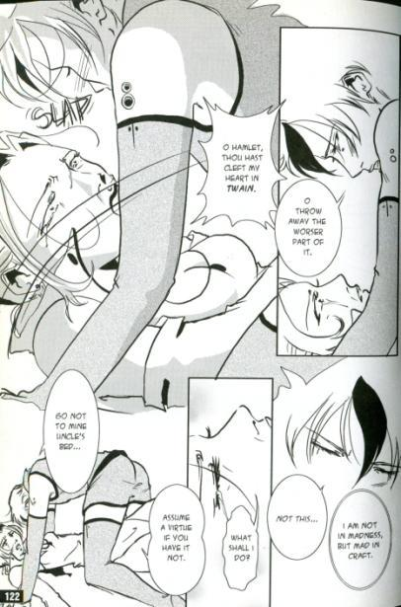
III.4.172-176
GERTRUDE O Hamlet, thou hast cleft my heart in twain.
HAMLET O, throw away the worser part of it,
And live the purer with the other half.
Good night: but go not to mine uncle's bed;
Assume a virtue, if you have it not.

Slide 130
III.4.177-169
That monster, custom, who all sense doth eat,
Of habits devil, is angel yet in this,
That to the use of actions fair and good
He likewise gives a frock or livery,
That aptly is put on. Refrain to-night,
And that shall lend a kind of easiness
To the next abstinence: the next more easy;
For use almost can change the stamp of nature,
And either [ ] the devil, or throw him out
With wondrous potency. Once more, good night:
And when you are desirous to be bless'd,
I'll blessing beg of you. For this same lord,
Pointing to POLONIUS

Slide 131
III.4.198-203
HAMLET Not this, by no means, that I bid you do—
Let the bloat king tempt you again to bed,
Pinch wanton on your cheek, call you his mouse,
And let him, for a pair of reechy kisses
Or paddling in your neck with his damned fingers,
Make you to ravel all this matter out:
That I essentially am not in madness
But mad in craft. 'Twere good you let him know,
For who that’s but a queen, fair, sober, wise,
Would from a paddock, from a bat, a gib,
Such dear concernings hide? Who would do so?

Slide 132
Shakespeare and
Politics
Dr Lia Wen-Ching Liang
National Tsing Hua University

Slide 133
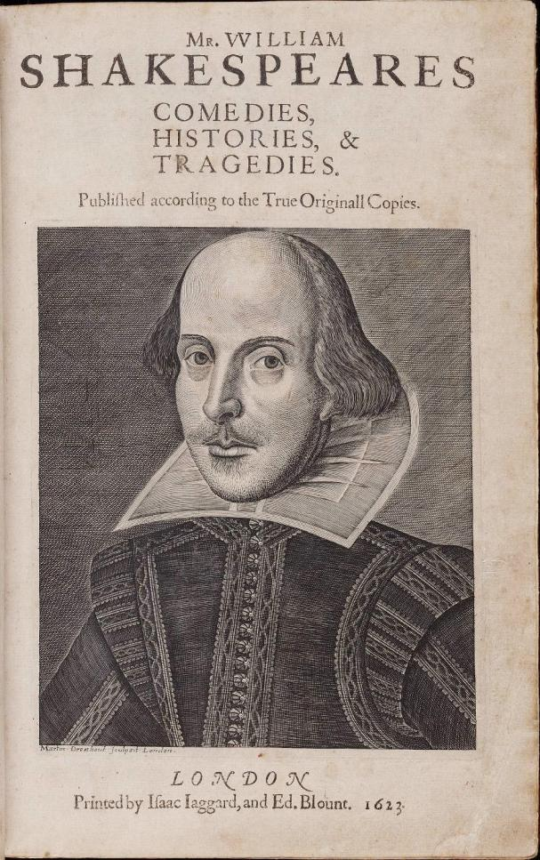
First Folio

Slide 134
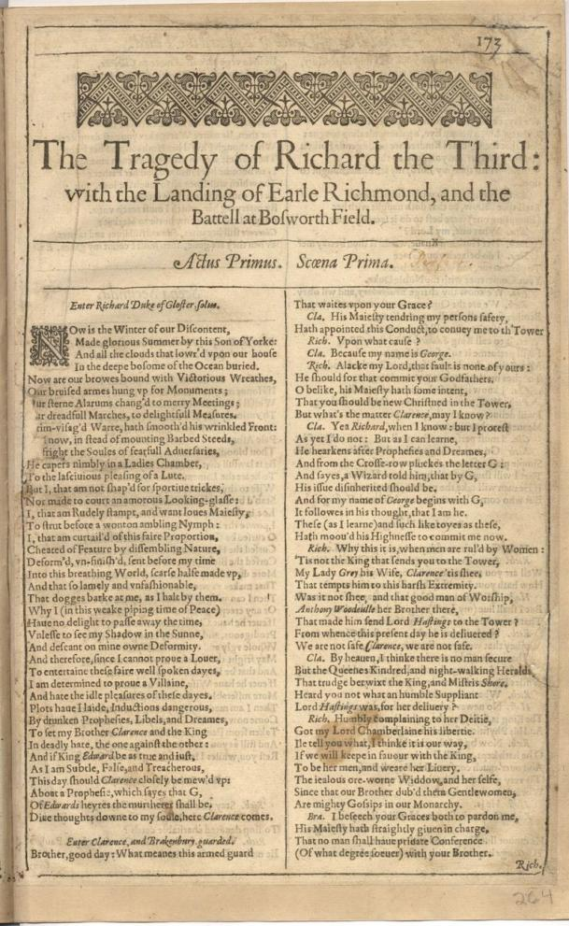
Richard III

Slide 135
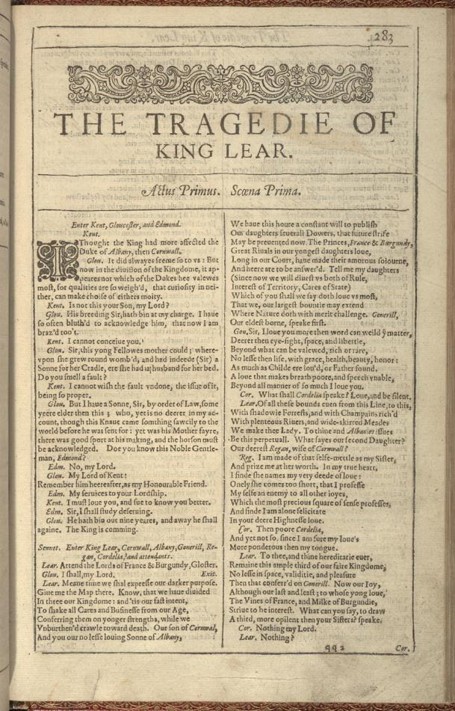
King Lear

Slide 136
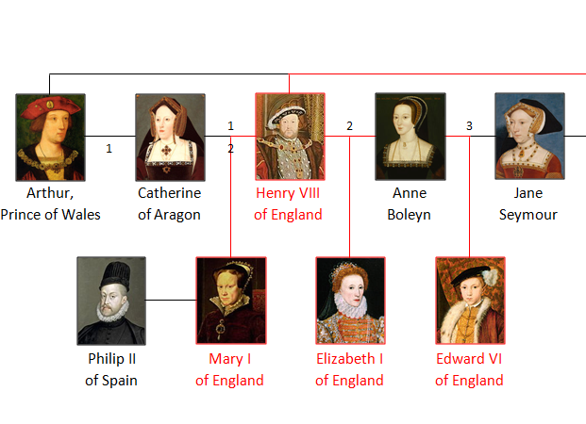
Reign
1553 – 1558
Reign
1558 – 1603
Reign
1547 – 1553

Slide 137
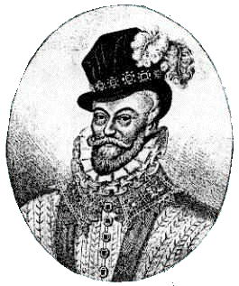
Lord Chamberlain’s Men
Richard Burbage (sharer, principal actor)
William Shakespeare (sharer by 1595)
John Heminge* (sharer)
Augustine Phillips
William Kempe (sharer, clown)
Thomas Pope
George Bryan
Richard Cowley
Samuel Gilbourne (child actor)
William Sly
Henry Condell*
John Sincler
*Shakespeare’s friends who compiled the First Folio
Henry Carey,
Lord Chamberlain

Slide 138

Queen Elizabeth
I

Slide 139



House of Tudor
House of Stuart
Family Tree:
House of Tudor and the House of Stuart

Slide 140

King
James
I

Slide 141


Slide 142

King Lear
First Quarto, 1608

Slide 143

Richard III

Slide 144

Richard
Burbage

Slide 145







Slide 146




War of Roses
The Red Rose of
House of Lancaster
The White Rose of
House of York

Slide 147

The Red Rose of
House of Lancaster
The White Rose of
House of York
House of Tudor

Slide 148

King
Richard
III

Slide 149
SCENE I. London. A street.
Enter GLOUCESTER, solus
GLOUCESTER
[…]
But I, that am not shaped for sportive tricks,
15 Nor made to court an amorous looking-glass;
I, that am rudely stamp'd, and want love's majesty
To strut before a wanton ambling nymph;
I, that am curtail'd of this fair proportion,
Cheated of feature by dissembling nature,
20 Deformed, unfinish'd, sent before my time
Into this breathing world, scarce half made up,
And that so lamely and unfashionable
That dogs bark at me as I halt by them;
Why, I, in this weak piping time of peace,
25 Have no delight to pass away the time,
Unless to spy my shadow in the sun
And descant on mine own deformity:
And therefore, since I cannot prove a lover,
To entertain these fair well-spoken days,
30 I am determined to prove a villain
And hate the idle pleasures of these days.
Plots have I laid, inductions dangerous,
By drunken prophecies, libels and dreams,
To set my brother Clarence and the king
35 In deadly hate the one against the other:
[...]

Slide 150


The remains
of
King Richard III

Slide 151

King
Henry
VII

Slide 152

House of Tudor

Slide 153
Richmond (King Henry VII):
O, now, let Richmond and Elizabeth,
The true succeeders of each royal house,
By God's fair ordinance conjoin together!
And let their heirs, God, if thy will be so.
Enrich the time to come with smooth-faced peace,
With smiling plenty and fair prosperous days!
(V.iii.396-401)

Slide 154


Laurence Olivier
Ian McKellen

Slide 155


Simon Russell Beale
Antony Sher

Slide 156


Kenneth Branagh
Kevin Spacey

Slide 157



Slide 158


Slide 159


Slide 160
Richard III

Slide 161
Shakespeare’s London
The City
1590

Slide 162

London in the 1590’s

Slide 163


Slide 164

Old St Paul’s Cathedral

Slide 165

Old St Paul’s after 1561 lightning fire

Slide 166

Preaching at Old St Paul’s

Slide 167

Staple Inn, High Holborn, London

Slide 168

Oxford Arms, Warwick Lane,
London

Slide 169

New Inn, Gloucester

Slide 170

Wyngaerde's "Panorama of London in 1543"

Slide 171

Old London Bridge c.1450

Slide 172

Rowing across the Thames

