Slide 1
The Adventurous Mailbox
Andrew Bliss

Slide 2
Inspiration 1: Lack of diversity

Slide 3
And this guy…

Slide 4
Education

Slide 5
“An unexamined life is not worth living” ~ Socrates

Slide 6
Everyone in this room is crazy!
“Entrepreneurs are the CRAZY people who would rather work 100 hours a week for themselves than work 40 hours a week for someone else.”

Slide 7
After Education

Slide 8
Inspiration to move abroad: These kids:

Slide 9
New Asian home…

Slide 10
Inspiration 2: Thailand

Slide 11
Inspiration 3: My country needs this…

Slide 12
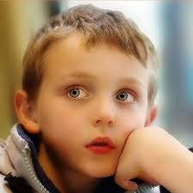
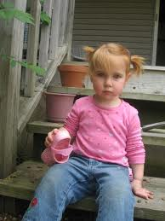
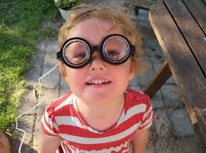

Slide 13
Lesson Learned: It’s OK To Make Mistakes!

Slide 14
The Adventurous Mailbox was born!

Slide 15
My Biggest Mistakes:
1: Lack of Focus
2: I was a control freak

Slide 16
My Biggest Obstacles:
1: Location
2: Being a foreigner in Taiwan

Slide 19
What I did right:
1: Something I knew
2: Something I loved
3. Something that had value
4. Something that inspires

Slide 20
My baby…

